Slide 1

Getting a Good Night's Sleep
An Exploratory Data Analysis Project for a sleep tracking start-up
By
Victoria Nwobodo

Slide 2
INTRODUCTION
Sleep is essential for both physical and mental health, supporting immune functions, muscle recovery, and overall vitality.
Quality sleep repairs cells, enhances memory, concentration, and problem-solving skills, improving daily performance and decision-making.
Adequate sleep helps regulate emotions, reducing stress, anxiety, and the risk of mood disorders like depression.
In this project, I intend to analyze sleep data from a Sleep app to uncover insights into lifestyle factors affecting sleep quality and its duration.

Slide 3
SITUATION
SleepInc. is a start up company that tracks customers sleep pattern from their new tracking app called Sleep Scope app.
The company is interested in finding out if there exist a relationship between human life style behaviors such as exercise, occupation etc and sleep quality.

Slide 4
TASK
Analyze lifestyle survey data with python to discover relationships between exercise, gender, occupation, and sleep quality.
Identify patterns leading to insights on sleep quality.
.

Slide 5
ACTION TAKEN
Data Cleaning: Cleaned the data set to remove inconsistencies, checked for duplicates, standardized data types etc
EDA – Performed univariate and Bivariate analysis to uncover insights
.

Slide 6
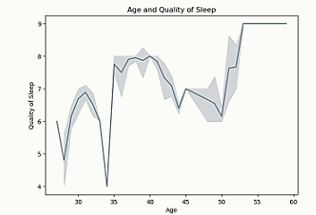
INSIGHTS
The quality of sleep varies significantly across different ages, for customers aged (30s-40s), sleep appears to have high variations and of poor quality.
Older adults (50+) seem to experience better sleep quality.
Although there are fluctuations, there seems to be an upward trend in sleep quality as age increases, especially after age 50.
The quality of sleep appears more stable and higher for individuals in their mid-50s compared to younger age groups.

Slide 7
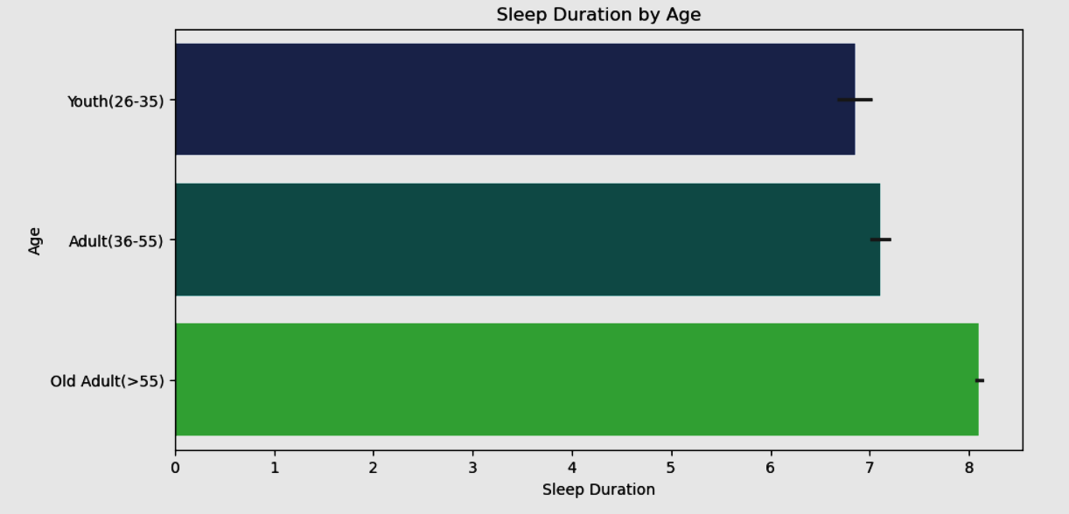
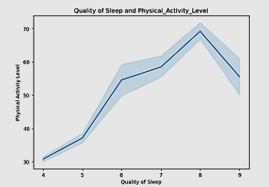
INSIGHTS
Around ages 50 and above, there seems to be an increase in sleep duration.
Sleep quality improves as physical activity level increases.

Slide 8
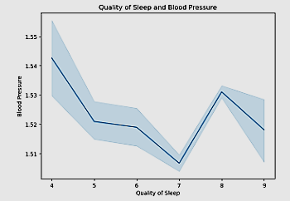
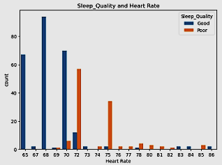
INSIGHTS
As sleep quality increases, blood pressure decreases, suggesting better sleep is associated with lower blood pressure, lowest blood pressure levels observed at a sleep quality of 7
Lower Heart Rates Are Associated with Good Sleep Quality while Higher Heart Rates Are Associated with Poor Sleep Quality

Slide 9
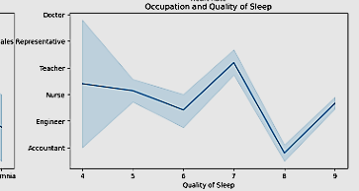
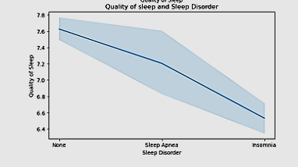
INSIGHTS
Doctors and Nurses Experience Moderate Sleep Quality
Teachers Show Significant Fluctuations
Engineers and Accountants Show an Upward Trend
Sales Representatives May Experience Poorer Sleep .
Customers with sleep quality above 7 were noted to have no sleep disorder.
Those with sleep quality of about 7hours have sleep Apnea
Those with sleep quality below 7hours have insomnia

Slide 10
CONCLUSION
From the above charts, its safe to conclude that our daily habits and activities affects the quality of sleep we get which in turn affects some basic health indicators.
Older adults (50+) seem to experience better sleep quality, we may need to explore factors contributing to sleep disturbances in younger adults,
We also noted that regular physical activity contributes to better sleep quality, over-exercising may impact sleep beyond a certain threshold (sleep quality 9), moderation is key.
Better sleep quality is linked to lower blood pressure whereas extremely poor or excessive sleep may lead to higher blood pressure, indicating that a balanced sleep routine is best for heart health.
Higher Heart Rates Are Associated with Poor Sleep Quality and vice versa
Customers with demanding jobs have poor sleep quality than those whose jobs are a bit more structured .

Slide 11
Thank you

